Slide 1
The Zen of PowerShell
A guide for C# Developers

Slide 2
About me
C# programmer in the city working on energy trading
My main use of PowerShell to support CI/CD using MS Release Management
Not a PowerShell Expert
Mostly this is about confusing stuff for C# developers.
Twitter @peteri

Slide 3
This bit is important!
Time to fire up PowerShell
Arrays are comma separated
Calling .Net code needs a parenthesis (section 7.1.3)
Pretty sure eventually calls MethodInfo.Invoke (code path is a bit tricky in coreadapter.cs)
So .Net methods use (p1,p2,p3)
PowerShell functions use p1 p2 p3

Slide 4
Returning stuff
Return doesn’t do what you might expect.
Simple example to confuse .Net programmers
Output wasn’t what we expected
Stuff that isn’t assigned to or piped to out-null gets written to the output pipeline… More on pipelines later

Slide 5
Writing stuff to outputs
Back to powershell for Write-Host & Write-Output
Other types of write:
Write-Verbose, Write-Information, Write-Debug, Write-Error
Write-Progress – use for a progress bar
Hey what? Nothing happened
Add Params() & [CmdLetBinding()]
CmdLetBinding means we don’t need to explicity set $VerbosePreferences etc..

Slide 6
Now for some pester
What did we learn?
Arrange - Describe & Context group tests and give life cycle for mocks
Mocks are easy to create but you can only mock native powershell.
Act – It runs the command or calls a function
Assert – “Should” Be performs assertions, lots of variations such as Should Exist, Should belike etc… Assert-MockCalled – can check for calls

Slide 7
Other things
The TestDrive provides an isolated files system
It does leak however and you can see the full temporary path
ScriptAnalyzer can give useful information
Variable scoping can easily bite you.
You can get code coverage results from your tests
Worth doing to check error handling
Mock objects can force errors

Slide 8
Important
Pester doesn’t compare collection types well.
Go here for the gory details
https://github.com/stuartleeks/PesterMatchArray

Slide 9

2016 a bad year for celebrities
David Bowie
George Michael
Carrie Fisher
Prince
And this Guy
Dick Bradsell

Slide 10
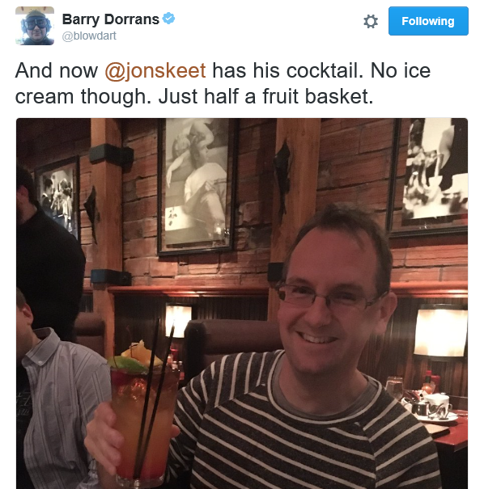
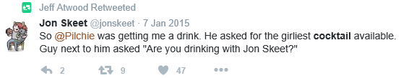
He created these cocktails
Espresso Martini ("wake me up, and then f**k me up“)
Bramble
Treacle
Wibble
So I decided to do a cocktail based demo….. (also this)
I’m in good company here

Slide 11
Cocktails three ways
Webservice

Slide 12
Cocktails three ways
Webservice
Convert to powershell module

Slide 13
Cocktails three ways
Webservice
Convert to powershell module
Write in C#

Slide 14
What did we learn from this
Parameters can be pretty flexible.
The pipeline really is the way you should work.
Formatting with custom formats isn’t that hard.
Modules need functions and variables exporting.
For our C# version it was worth adding the “magic” formatting stuff.

Slide 15
Thanks – contact details etc…
Powershell – Good, bad and weird lightning talk – Friday Lunch
Twitter : @peteri
Github for talk
https://github.com/peteri/NDCLondon2017
Useful cheat sheet for powershell @,{}() etc
https://www.simple-talk.com/sysadmin/powershell/the-complete-guide-to-powershell-punctuation

